Slide 1

We would like to acknowledge the Whadjuk Noongar people whose traditional land we gathered on today, and pay our respects to their elders past, present and emerging.
Workshop
Native Vegetation Clearing Approvals
June 2025

Slide 2

Session Agenda
Why are we here and what do we need
Schedule we are working to
Scene Setting
Workshop item 1 – High Level Benefits (~15mins)
Workshop item 2 – Functional Scope (~45mins)
Workshop item 3 – Risk (~15mins)
Wrap-up

Slide 3
Informing the PDP/Business Case
We aim to verify the following to inform the updated EO business case to government (referred to as a ‘project definition plan’)
Strategic Intent and scope of functionality
High level requirements
What could we do for customers and staff now, next and later
Existing systems we are replacing
Data Quality and Migration

Slide 4

High level schedule

Slide 5
Scene Setting

Slide 6
Vision
Environment Online is envisaged to be a digitised environmental regulatory and assessment platform that integrates the regulatory cycle and creates a quality online experience for staff, industry, developers, customers and the community.
Notes:
Facilitation notes
A reminder of the current EO vision framing the overall PDP case and investment.
The strategic vision is retained from the original business case. We have confirmed this and remind the executive team on what we continue to work towards.
This vision continues the journey of an integrated, streamlined and common approach to regulatory approvals and compliance delivery, for both customers and staff.
Other minor variations used in the PDP
Environment Online is envisaged to be a digitised environmental regulatory platform integrating the regulatory cycle and creating a quality online experience for staff, industry, developers, customers and the community (cover page)

Slide 7
Objectives
1. Streamlined Business Processes | Automated, optimised forms and workflows, resulting in less complex and more efficient processes.
2. Regulated Environmental Health | Ability to access more complete and timely information to inform assessment decisions and help safeguard the environment.
3. Improved User Experience | Accessibility to services will be improved through 24/7 access to a self-service portal from anywhere, any device.
4. Trusted Data and Information | A single source of trusted information and data will support the provision of higher quality and evidence-based advice and decision making. Much of the necessary information will be captured automatically through digital applications as a byproduct of electronic processing rather than manual functions.
5. Adaptive Culture | More capacity for joint planning and decision making, including easier access to latest information about decision making will enable more effective use of staff training, skills and capabilities; building organisational excellence a more satisfying and responsive service delivery.
6. Innovative Technology | Secure and future proof our systems, reducing the risk of system failure, cyber security incidents and the need to constantly upgrade on-premise systems
7. Improved Financial Management | Addressing weaknesses in the design and implementation of controls and processing of cost recovery and fees payable by proponents.
Notes:
Facilitation notes
7 key objectives from the original business case frame the vision and will continue to feature in the PDP.
The objectives a key to framing the PDP investment and provides a key guidance to the design and delivery of business and EO change in collaboration with staff and customers.

Slide 8
Design Principles
One portal and unified experience for DWER customers
A common, integrated approach to regulatory assessment stages
Reuse and improvement of common EO functions
Ask once where we can, share and reuse key data
Incremental, valued and viable changes, informed with actual use
Digital systems enable streamlined processes and rules
Process change reflects key strategic reforms and direction – such as but not limited parallel processing and deemed decision making

Slide 9





Current Functionality
Environmental
Impact Assessments
Native Vegetation Regulation
Phase 1
Industry
Regulation
Phase 1
Fees and
Payments
Common
Capabilities
Referrals and associated applications under Part IV of the Environmental Protection Act 1986
Ability to lodge and track native vegetation clearing permit applications
Ability to submit all application types, including
annual fees and compliance plans and reports
Integrated payment solution for Environmental Impact Assessments (EIA) submitted through Environment Online.
Geospatial Services
Data & Analytics
Enquiries
Expert Advice
RFI’s
Customer portal
+ ongoing minor releases incorporating a range of product enhancements and bug fixes, as well as the establishment of new features

Slide 10



Functionality under development
Functionality below is currently in train and at varying stages of development:
Planning Advice
Industry
Regulation Phase 2
Water Licensing
Survey Data for Approvals
Unified Application and Dashboard
Will integrate Planning Advice functionality for both Water and Environmental Land use on the platform.
Digitise all application forms and extended portal dashboard functionality.
Management of water licensing activities self service capability and improved status and tracking visibility
Allow submission of Marine and Biodiversity field survey data as part of their regulatory assessment referrals
Analysis and concept design works on new
application and improved customer dashboard options
+ ongoing minor releases incorporating a range of product enhancements
and bug fixes, as well as the establishment of new features

Slide 11





Up and coming functionality
What is still to come..
Parallel Decision Making and Processing
Native Vegetation Regulation
Phase 2
(Assurance)
Compliance and Enforcement
Controlled Waste Licensing and Tracking
Contaminated
Sites
Detailed analysis and targeted updates to help customers and staff track, workflow and manage parallel approvals
Digitise all application forms and full case management for
clearing approvals
Unified case mgmt. and analytics for water and environment compliance and enforcement
Management of all controlled waste licencing and digital
waste returns and tracking solution
Supporting the
assessment, remediation and management of contaminated sites
+ ongoing minor releases incorporating a range of product enhancements
and bug fixes, as well as the establishment of new features

Slide 12
EO for Clearing – current state
What we currently have in EO for the Native Vegetation / Clearing:
Basic knowledge base detail available for the public and customers.
Customers can register and submit all Clearing Forms via the EO portal.
Customer post login, can view their dashboard and includes EO clearing applications.
Customer can also choose to use the existing email pathway for forms.
Customer can submit: F04 Amendment, F05 Transfer, F06 Surrender, F01 New Clearing Permit.
Applications via EO are attachment based, i.e. digital basic. They are not smart forms.
Attachments are stored in EO Sharepoint.
A EO Dynamics model driven application is used by clearing officers to open, validate and process the applications.
Applicable data is re-keyed into the existing CPS system and processing continues via CPS.
One Stop Shop Design Files – Figma

Slide 13
Workshop Item 1
What we are setting out to do and the benefits of doing so

Slide 14
Statement of Strategic Intent
What are we setting out to do
Environment Online will be expanded to deliver the remaining Native Vegetation clearing referral process covering all 5 stages of assessment.
This will also include support for delegated clearing approval as undertaken by DEMIRS, and the processing of clearing offsets applicable to the referral.
With the migration to EO, what do you believe/hope the Key Benefits for GOVERNMENT AND CUSTOMERS will be?
One area for customers to go into and submit, removing duplication across multiple requests for multiple approvals/assessments
Clarity for the customer to self-service to get regular updates on progress
Functionality for DEMIRS and DWER staff to be able to work together for the pieces of work (thinking resources online and EOL integration/communication ability
Cross sector teams ability to access and gain a clear understanding of current progress and next steps to be able to communicate effectively (CRM type functionality)
Ability for customer to raise a concern/question during the process for the assessment officers then able to respond (CRM type)
Ability to pull reports/data and use them for multiple purposes

Slide 15
Statement of Strategic Intent
What are we setting out to do
Environment Online will be expanded to deliver the remaining Native Vegetation clearing referral process covering all 5 stages of assessment.
This will also include support for delegated clearing approval as undertaken by DEMIRS, and the processing of clearing offsets applicable to the referral.
With the migration to EO, what do you believe/hope the Key Benefits for STAFF will be?
Ability to remove the manual processes and be intuitive to both the staff and customer
Clear data that they can use to answer customer queries - transparency
Ease of working with colleagues both in DWER and across other agencies (data driven conversations) - technology won't replace the conversation but should improve the experience
Customer self-serve to relieve the assessment officers to be able to focus on those high risk, high priority assessments when customers need that
Ability to register/request/note the assessments under parallel decision making to allow the conversations to happen between DMAs

Slide 16
Workshop Item 2
Scope and functionality

Slide 17

Reflection 1 - Native Vegetation Regulation
LEVEL 1 – FUNCTIONALITY - What we believe are the major areas of functionality
Stage 1
Pre-Application
Stage 2
[Apply &] Validation
Stage 3
Assessment
Stage 4
Decision Review
Stage 5
Instrument Mgmt.
Compliance
Monitoring & Reporting
Stages of
Assessment
Features
Application
Application
[Business]
Validation
Assessment
Decision
Decision
Recommend
Instrument
Management
Compliance
Monitoring
Common Features (often connected to 1 or more stages OR called upon independent of a stage, e.g. person registration, reporting)
Person & Party Registration
and Rights Management
Enquiry
Expert
Advice
Public
Advertising and
Consultation
Requests
for Information
Fees and Payments
(Inc. refunds, adjustments)
Offsets
(EPA and NV)
Appeals
Reporting and Analytics
Conditions
Library
Management
Knowledge
Base (staff, customers, public)
Correspond-ence
Management
Document and Record
Templates and
Generation
Customer and Staff Dashboards
Survey
Data
(IBSA/IMSA)
Notifications
(email, portal, case mgmt)
Task
Management
Attachments and File Store
Geospatial Data Management
(store, view, validate)
Public Search and Display of Published Records
Think of a boxes as stepping stones on the path to completing the big picture intent. Each include user stories (requirements) that, when pieced together, deliver a valuable chunk of functionality for stakeholders.

Slide 18
Reflection 2 - Native Vegetation Regulation
LEVEL 2 – FUNCTIONALITY What we captured in the 2020 Business Process Master List (epics/features/user-stories)
Enquiry
Application
Application [Business] Validation
Assessment
Decision
Decision
Recommend
Instrument
Management
Data
Reporting
Other
Requirements
Scope
Enquiry
Applicants
Identity
Application
Received
Land
Ownership
Native Title
Check / Validation
Bioregional
Rule Setting
Decision
[Determination]
Appeals
Correspond-ance
Maintain
Offset
Register
(interface only)
Reporting
Workload
Management
Process
Stages
Application
Form
Accept
Application
CAWS & RIWI
Check / Validation
Direct
Interests
Desktop
Assessment
Submissions
Workload
Management
Maintain
Reference
Data
KPI
Reporting
Record
Keeping
Amendment
Application
Declined
Commonwealth Check / Validation
Amendments
Validation
External
Advice
Decision
Package
Tracking
Subdivision
Approvals
Data
Lake
Customer
Information
Application
Fee
Geospatial
Exempt
Check
Workload
Management
Site
Visit
Appeals
Compliance
[schedule
and reporting]
Data
Sharing
Document
Management
Fee
Payment
Assessment
Pathways
Interested Parties
Native vegetation check
Application
Type
Advertise
Appeals
Record
Keeping
Business Rules
Advertise
Application
Fee
Payment
Progress
Visualisation
Offsets
Consultation
Maintain
Statistics
Release 2
and 3
EPICS in the BPML with 1 or more features
DEMIRS
(access for, refer to)
Notification
Period
Fee
Amendment
Survey
Reports
Features in the BPML with
user stories / requirements
Commonwealth
(access to, add to, refer to)
[request]
Further Information
Fee
Refund
Env.Impact Assessments
Conditions
Common in EO for current state build
EPA Referral
(Part 4 check and link)
External Agency (gen docs, notify)

Slide 19
Reflection 3 - Native Vegetation Regulation
What has been established (at a high level) in current state (release 3 + 4)
Stage 1
Pre-App
Stage 2
[Apply &] Validation
Stage 3
Assessment
Stage 4
Decision Review
Stage 5
Instrument Mgmt.
Compliance
Monitoring & Reporting
Applicants
Identity
Customer Dashboard
Customer Experience
(One Stop Shop Portal)
Application
Form (draft, submit, track)
Amendment
Application
Geospatial
(GIS Maps- Draw & Upload)
[Attachments]
Document
Management
Both
Enquiries
Account Management & Profile Update
Customer
Information
[and manage access rights]
[request]
Further Information
Officer Dashboard
Appl.Timeline (activities, posts, notes, interactions)
Generate Documents
Accept
Application
Application
Received
Staff Experience
(Case Management)
Geospatial
(GIS Maps- Draw & Upload)
Interested Parties
Expanded Features from development work
Notes:
Training Materials
wawater.sharepoint.com/:b:/t/EOP.Team/EQQLpG4eCZBHuNQlZIltf_EBpTvuR67Wt6btLx0TnjLTqg?e=1btMry
Application Form – sub features
NV-F01 Application for new permit or referral -(Release 3)
NV-F06 Application for surrender (release 4)
NV-F05 Notification of transfer of area permit (Release 4)
NV-F04 Application for an amendment (Release 4)
PORTAL - NV-F01 Pre-Application Scoping
PORTAL - NV-F01 Introduction - Alert banner
PORTAL - NV-F01 Attachments
PORTAL - NV-F01 (Referral, Area, Purpose) Validation
PORTAL - NV-F01 (Referral, Area, Purpose) Update: Provide the reason for proposed clearing
PORTAL - NV-F01 (Referral, Area, Purpose) Surveys for assessments (IBSA and IMSA)
PORTAL - NV-F01 (Referral, Area, Purpose) Proposed Clearing
PORTAL - NV-F01 (Referral, Area, Purpose) Other approvals
PORTAL - NV-F01 (Referral, Area, Purpose) Land details (Without mapping)
PORTAL - NV-F01 (Area, Purpose) Assessment bilateral agreement
PORTAL - NV-F01 - Applicant can indicate, when unsure if clearing permit is a controlled action
PORTAL - NV-F01 - Applicant can indicate, authority to clear land - without landowner approval
PORTAL - NV Form 1 (Referral, Area, Purpose) Proposed clearing end date functionality
Portal - NV - Declaring Multi Applicant application
PORTAL - Withdraw a submitted NV application
PORTAL - NV-F01 Attachments
NV-F01 GIS maps
Enable base functions for Native Vegetation
DYNAMICS - NV Request for information (RFI) - (Base)
Dynamics: Add interested party as a Contact to the NV application

Slide 20
Feature Questions
Looking over the reflection slides;
without getting to the detail on what each feature is; from a high-level scan over the features, what % confidence level do you have that we have them covered?
<value here> %
Review reflection slides 1 and 2 –
What must have features are missing at a high level / whole of system ? (consider key functions for customers and/or staff)
Customer service portal
Automated application forms, intuitive to the users
…
What features or groups-of do you believe most complex or concerning and therefore, a high risk to deliver and why?
A
B
…
Notes:
Stages of assessment for native vegetation clearing permits | Western Australian Government

Slide 21
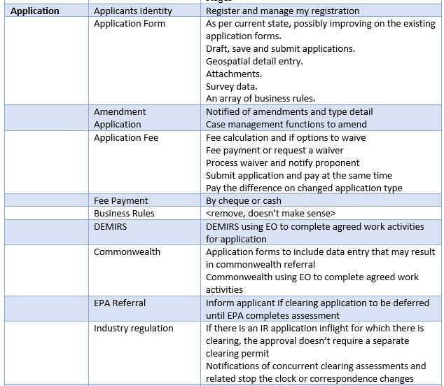
Reflection 2 - Native Vegetation Regulation
LEVEL 2 – FUNCTIONALITY What we captured in the 2020 Business Process Master List (epics/features/user-stories)
Application
What must have features are missing?
Applicants
Identity
Application
Form
Amendment
Application
Application
Fee
What could we do for customers OR staff that would significantly benefit?
MUST improve on the application form and commonality – intuitive application forms
Fee
Payment
Business Rules
DEMIRS
(access for, refer to)
Commonwealth
(access to, add to, refer to)
EPA Referral
(Part 4 check and link)

Slide 22
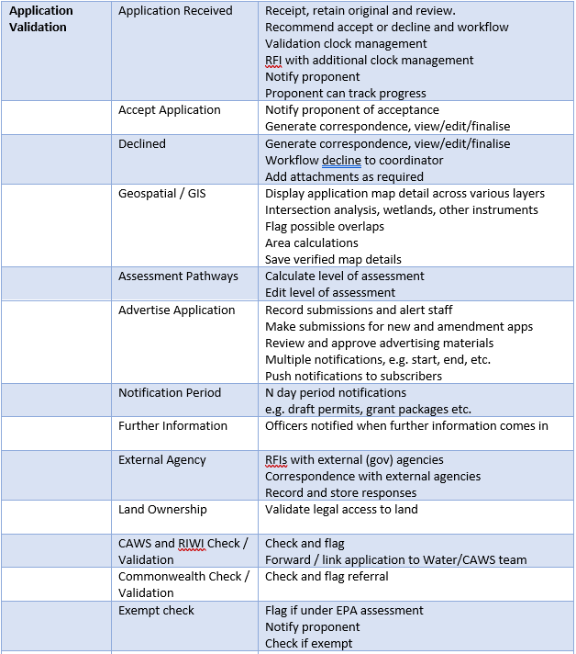
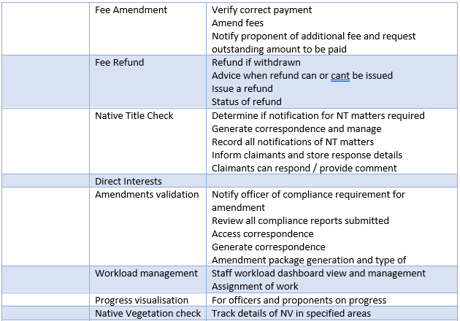
Reflection 2 - Native Vegetation Regulation
LEVEL 2 – FUNCTIONALITY What we captured in the 2020 Business Process Master List (epics/features/user-stories)
Application [Business] Validation
Application
Received
Land
Ownership
Native Title
Check / Validation
Accept
Application
CAWS & RIWI
Check / Validation
Direct
Interests
Declined
Commonwealth Check / Validation
Amendments
Validation
Geospatial
Exempt
Check
Workload
Management
Assessment
Pathways
Interested Parties
Native vegetation check
Advertise
Application
Fee
Payment
Progress
Visualisation
Notification
Period
Fee
Amendment
[request]
Further Information
Fee
Refund
External Agency (gen docs, notify)

Slide 23
Reflection 2 - Native Vegetation Regulation
LEVEL 2 – FUNCTIONALITY What we captured in the 2020 Business Process Master List (epics/features/user-stories)
Application [Business] Validation
What must have features are missing?
<type here>
Application
Received
Land
Ownership
Native Title
Check / Validation
Accept
Application
CAWS & RIWI
Check / Validation
Direct
Interests
Declined
Commonwealth Check / Validation
Amendments
Validation
Geospatial
Exempt
Check
Workload
Management
What could we do for customers OR staff that would significantly benefit?
<type here>
Assessment
Pathways
Interested Parties
Native vegetation check
Advertise
Application
Fee
Payment
Progress
Visualisation
Notification
Period
Fee
Amendment
[request]
Further Information
Fee
Refund
External Agency (gen docs, notify)

Slide 24
Reflection 2 - Native Vegetation Regulation
LEVEL 2 – FUNCTIONALITY What we captured in the 2020 Business Process Master List (epics/features/user-stories)
Application [Business] Validation
What must have features are missing?
Referral system
Change over from referral application to a CP application if the referral is deemed "Permit Required"
Application
Received
Land
Ownership
Native Title
Check / Validation
Accept
Application
CAWS & RIWI
Check / Validation
Direct
Interests
Declined
Commonwealth Check / Validation
Amendments
Validation
Geospatial
Exempt
Check
Workload
Management
What could we do for customers OR staff that would significantly benefit?
Easy access and system for those who are not digitally experienced /
Assessment
Pathways
Interested Parties
Native vegetation check
Advertise
Application
Fee
Payment
Progress
Visualisation
Notification
Period
Fee
Amendment
[request]
Further Information
Fee
Refund
External Agency (gen docs, notify)

Slide 25
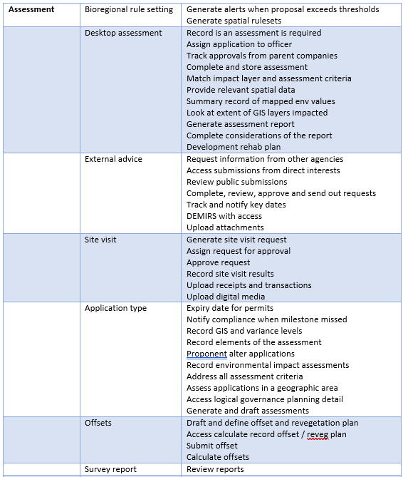
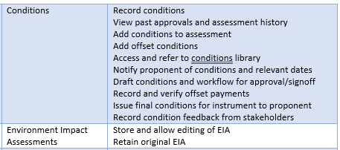
Reflection 2 - Native Vegetation Regulation
LEVEL 2 – FUNCTIONALITY What we captured in the 2020 Business Process Master List (epics/features/user-stories)
Assessment
Bioregional
Rule Setting
Desktop
Assessment
External
Advice
What must have features are missing?
<type here>
Site
Visit
Application
Type
Offsets
What could we do for customers OR staff that would significantly benefit?
<type here>
Survey
Reports
Env.Impact Assessments
Conditions

Slide 26
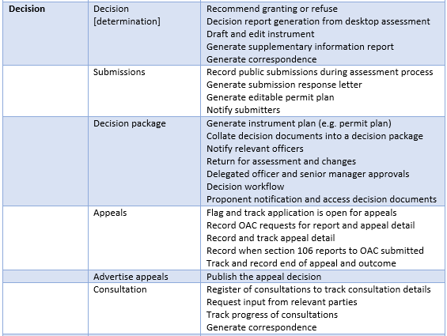
Reflection 2 - Native Vegetation Regulation
LEVEL 2 – FUNCTIONALITY What we captured in the 2020 Business Process Master List (epics/features/user-stories)
Decision
What must have features are missing?
<type here>
Decision
[Determination]
Submissions
Decision
Package
What could we do for customers OR staff that would significantly benefit?
<type here>
Appeals
Advertise
Appeals
Consultation

Slide 27
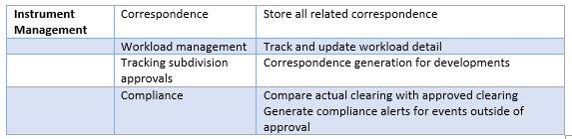
Reflection 2 - Native Vegetation Regulation
LEVEL 2 – FUNCTIONALITY What we captured in the 2020 Business Process Master List (epics/features/user-stories)
Instrument
Management
What must have features are missing?
<type here>
Correspond-ance
Workload
Management
Tracking
Subdivision
Approvals
What could we do for customers OR staff that would significantly benefit?
<type here>
Compliance
[schedule
and reporting]

Slide 28
Let us quickly loop back to ‘why’!
From our discussion of scope and features…so why do this? What are the benefits / savings / advantages?
Key Benefits for GOVERNMENT AND CUSTOMERS will be?
Key Benefits for STAFF will be?

Slide 29
Workshop Item 3
Risk

Slide 30
Risks
What are top 3 risks (in terms of likelihood and impact) for CUSTOMERS and STAFF/DWER and why?
For CUSTOMERS
If it's not easy to use, they may not use it
Access to previous application forms and data
For STAFF
Access to data, and ease of access to historical data
Front facing functionality is great, back-end functionality is manual and causing more work by not being user friendly
If the 'doors are not opened' between the different assessments, then PDM will not be enabled

Slide 31
END OF SESSION

Slide 32

Proposed Roadmap
PDP Year 1
PDP Year 2
PDP Year 3
2026 - 2027
2027 - 2028
2028 - 2029
Water Licencing & Resources
Unified Application and Dashboard
Native Vegetation Clearing and Offsets
Water and Env. Compliance and Enforcement
Controlled Waste Licencing and Tracking
Contaminated Sites
Parallel Decision Making and Deemed Decision Making
Common (ongoing updates, e.g. public consultations, published records search, etc)
Reporting and Analytics (ongoing updates)
Notes:
Facilitation notes
The draft PDP revised and proposed roadmap.
Running workshops over the next 4 weeks may influence this. We will come back to you after the workshops, and earlier if required.
From top to bottom
The key focus in alignment with the vision is the finalisation of the onboarding and integration of regulatory approvals for water and native vegetation clearing, reusing common functions, enhanced data reporting and analytics, and the common regulatory stages of assessment workflow. Clearing will include improvements for offset management in assessment processes for both EPA and Clearing.
As we bring in the final 2 regulatory approvals, we continue to enable applicable decision making and processing process, rules and pathways; and build on the one front door, unified application opportunities and dashboards.
Current water licencing systems include functionalities that are hardwired into basic water C&E activities for events/incidents/investigations and enforcement, with abilities to associate C&E records to parties, locations, instruments and the like.
This requires us to pull C&E into the 2026 period, and possibly earlier with detailed analysis covering W&E for C&E functionalities. There is also a possibility of exploring data analytics and reporting functions early with existing data holdings for key C&E insights for staff. There are likely other key strategic drivers for C&E and we will explore these and what we can do in a series of staged releases for staff and customers.
Finally. The program is working with Assurance and ISB regarding Controlled Waste, namely a potential offering for tracking built using the same platform technology as EO from EPA Victoria. That said, the timing has not changed at this stage.

Slide 33





What does this look like (~Q4 2025)
One Portal
(My Environment Dashboard and Security)
Case Management Applications – enabling specific and common process for key business services
Planning Advice
EPA
Approvals
Industry
Approvals
Clearing Approvals
Water
Licencing
Controlled Waste Licencing and Tracking
Water & Env.
Compliance and Enforcement
Contam.
Sites
Geospatial Platform
Common Functions (Enquires, RFI, Expert Advice, Fees and Payments, Survey Data for Approvals)
One Database
One Document Records Store (SharePoint)
Enterprise Data Lake / Warehouse Platform
Foundational Platform
Complete and improving
Under Development
Future Functionality

Slide 34

Native Vegetation Regulation
HIDDEN SLIDE – May assist with general reflections and a helper to see if we missed anything
Customer Portal
Customer Records
Application
(Apply)
Application Validation
Assessment
Draft Decision & Recommend
Instrument Management
Offset Management
Reporting and Analytics
Projects, Proposals and
Applications
Notifications and Preferences
Individual
and Parties
Registration and Management
Amendment
(proponent or department)
Parallel Determination and Linkage
Level of Assessment Determination
Draft
Decision and Recommend
Instrument
Compliance
Schedules
Offset Proposals Management
Status of Applications
Compliance Schedules and Reporting
Acting on
Behalf of and Access Rights
Exemption
Check and Management
Direct
Interests
Risk and Pathway Determination
Draft
Instrument and Proponent Review
Instrument
(condition) Compliance Reporting
Offset Determination
Survey Data
Management
Enquire
Accept or Decline Application
Legal rights, ownership checks
Manage Assessment Criteria
Instrument Conditions
Offset Condition Reporting
Offset Register Publication
Workload Dashboard, Management
and Tracking
Notifications and Preferences
Correspond-ence
RIWI, CAWS checks - flagging and assignment
SAT
Reviews
Application Progress Visualisation
Fees and Payments
Requests for Information
Clock Management
Tasks
Security and Access Rights Management
Common
Documents, Records and Data Management
Public
Consultations
and Advertising
Fees, Payments, Refunds, Adjustments
Survey Data for Approvals
Customer Notifications
(Portal, Email)
Appeals
Instrument
Conditions Library
Document
Attachments and Generation
Task Assignment and Management
Update personal and party details
Dashboard
Enquiry
Requests for Information
Correspond-ence
Generation and Management
Public Search and Display of Published Records
Expert Advice
(internal or external)
Reference Data
Management
Geospatial Data Management
Assessing Officer Notifications

