Slide 1
Renergi site works.
Lot 500
Gibbs Road
Collie
6225.

Slide 2
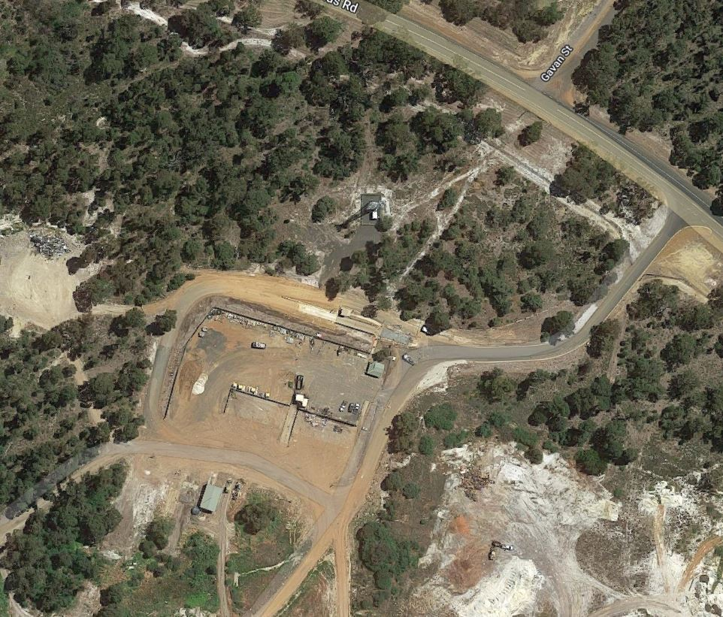
Option 1
Water meters
Western Power Transformer
Renergi site main switchboard
Trench for water supply
Trench for electrical supply
Route of shared trench
Underground boring

Slide 3
Option 2
Water meters
Western Power Transformer
Renergi site main switchboard
Trench for water supply
Trench for electrical supply
Route of shared trench
Underground boring

Slide 4
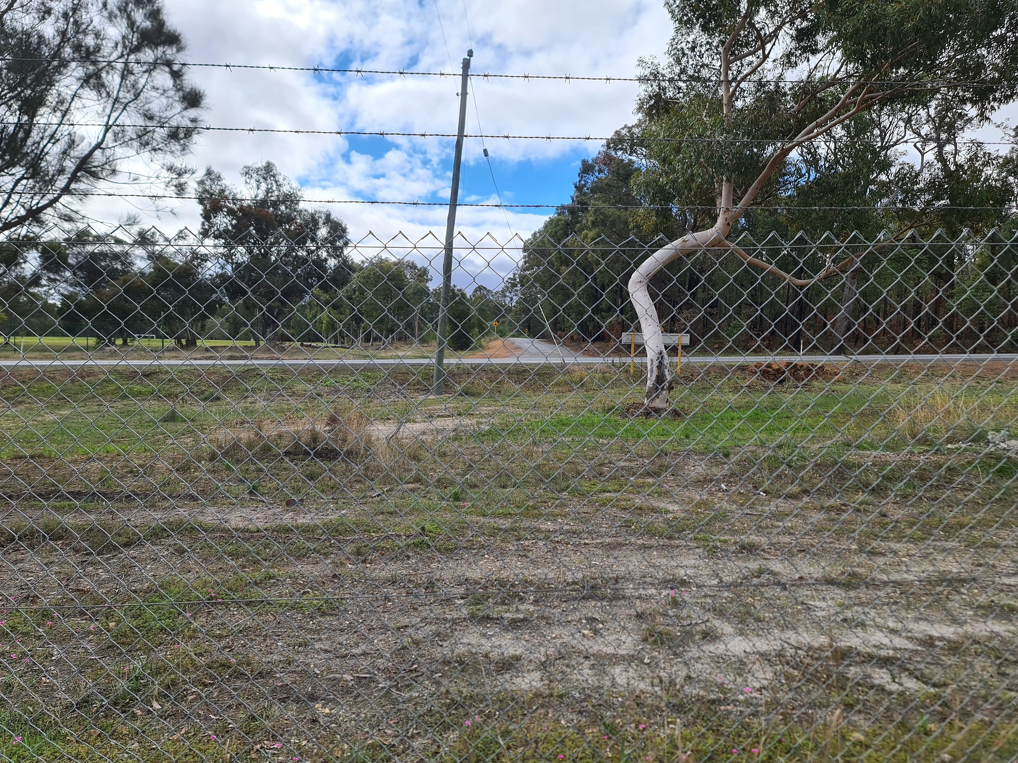
Route between Western Power transformer and Renergi site main switchboard.

Slide 5
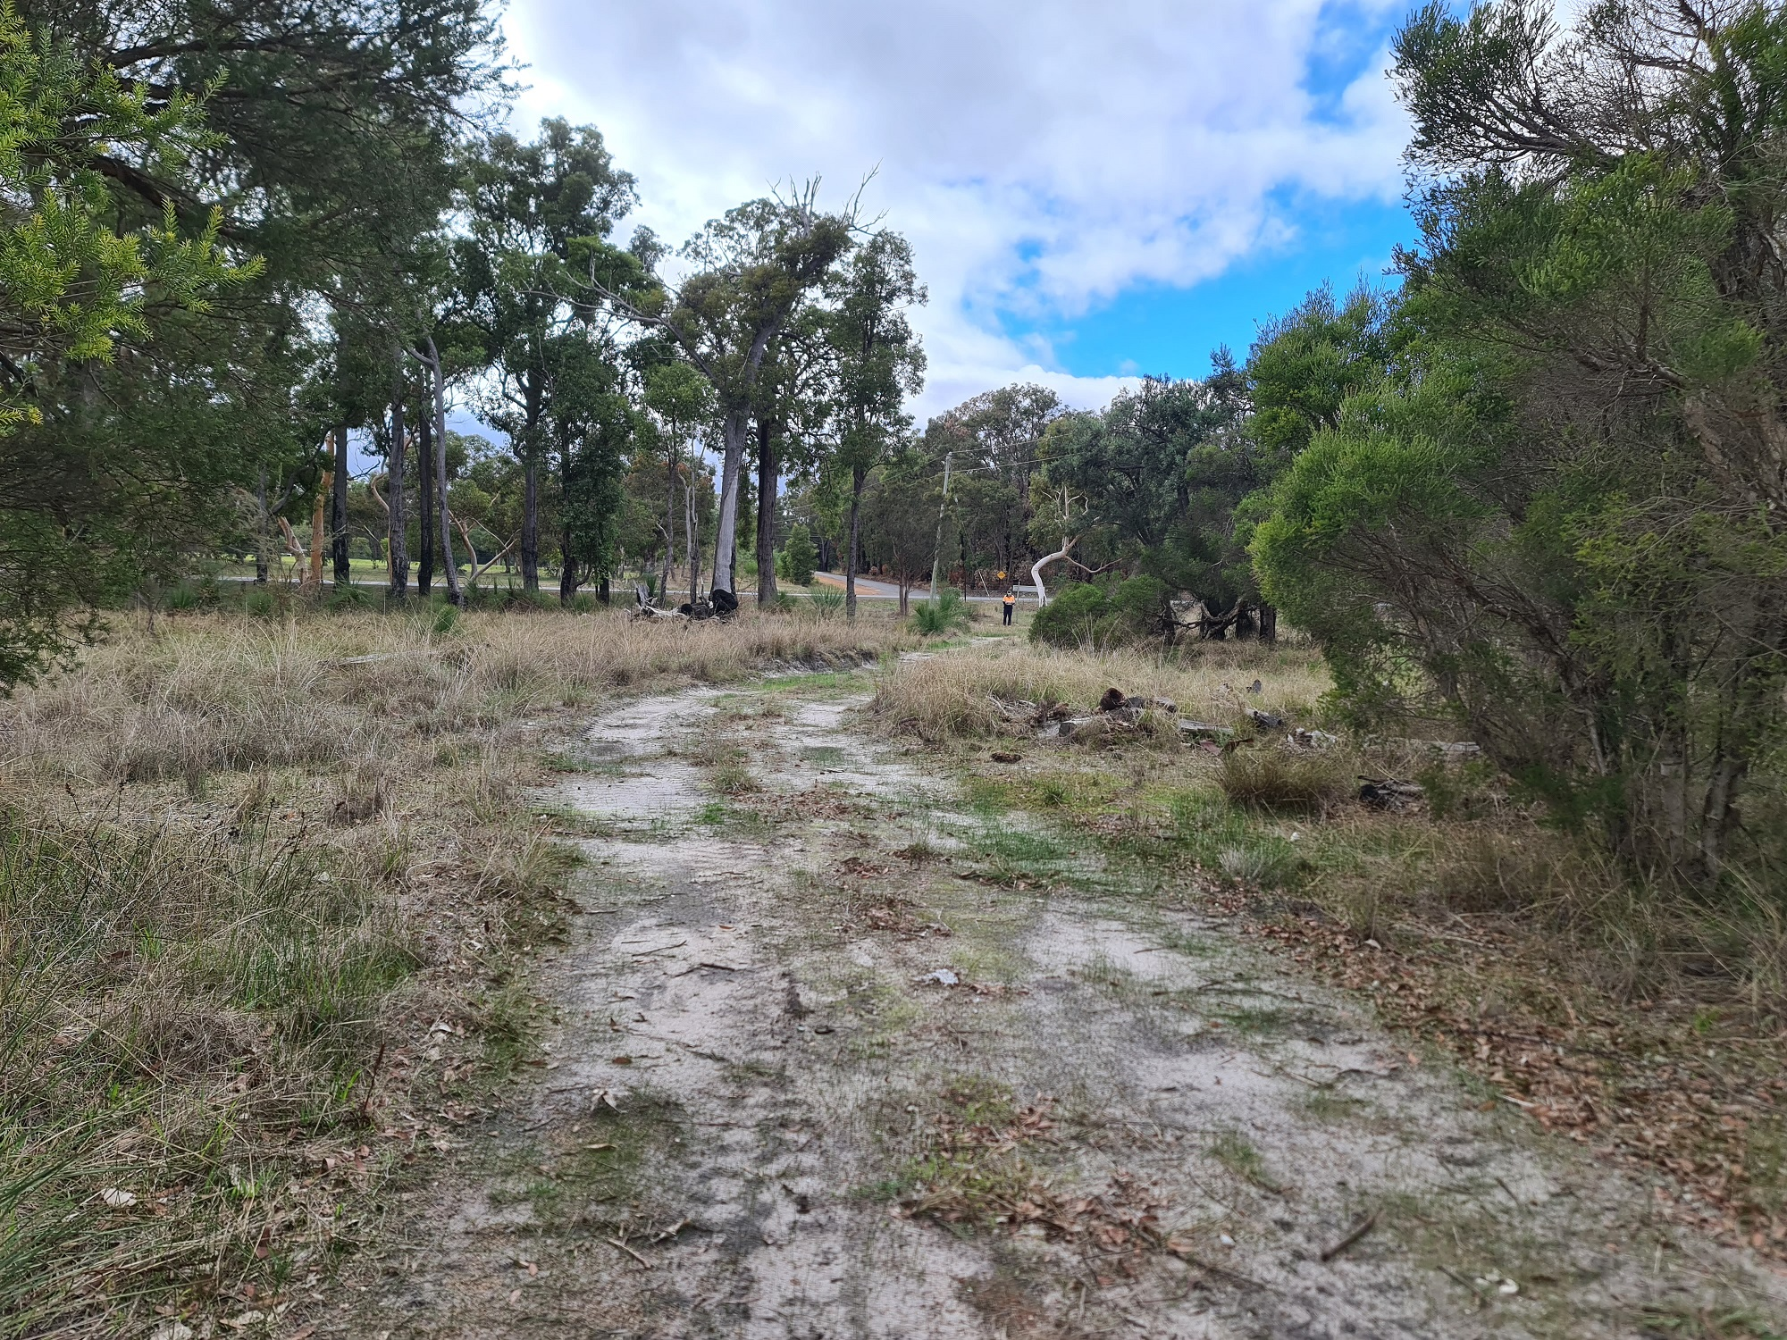
Route for electrical supply trench.

Slide 6
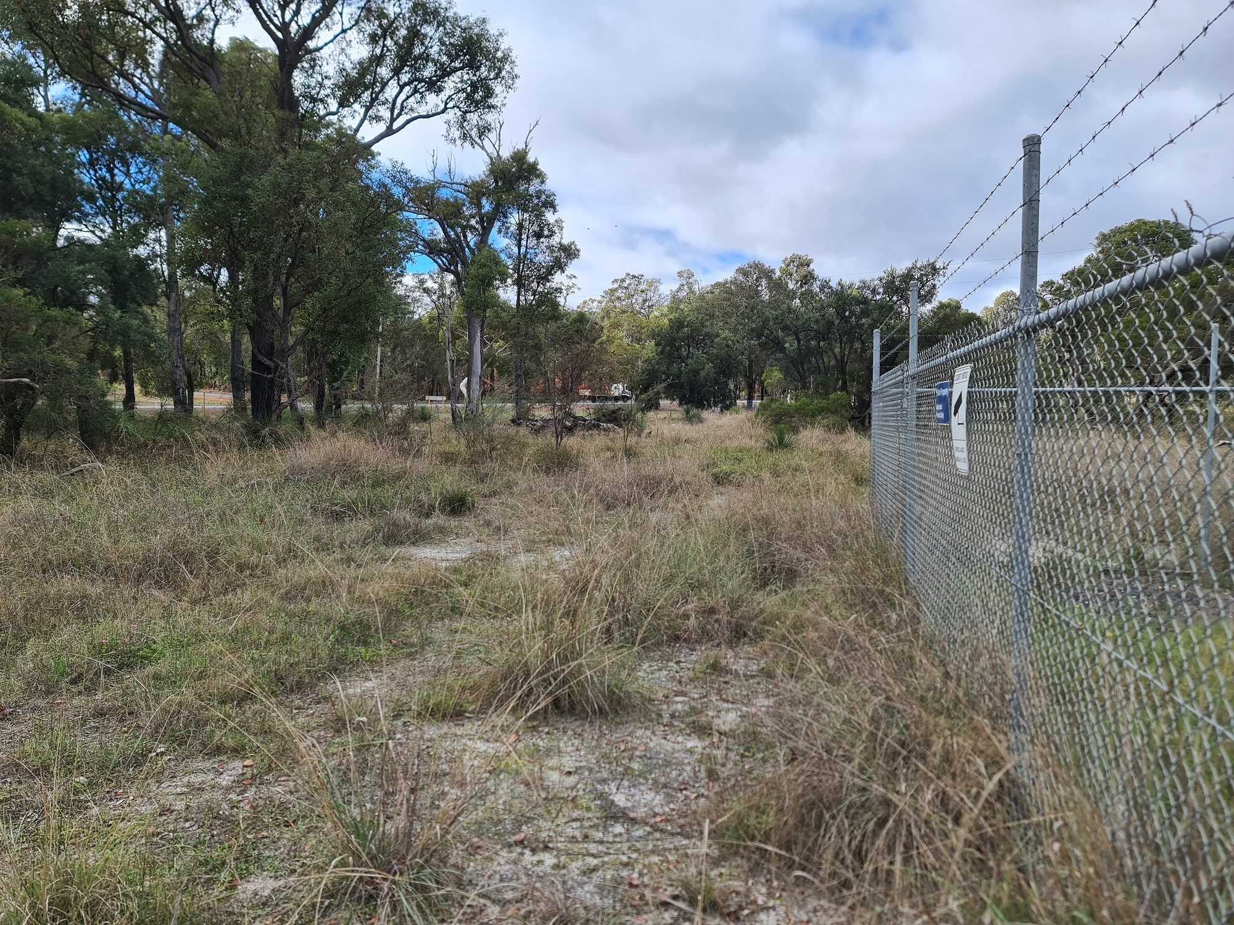
Route for electrical supply trench.

Slide 7
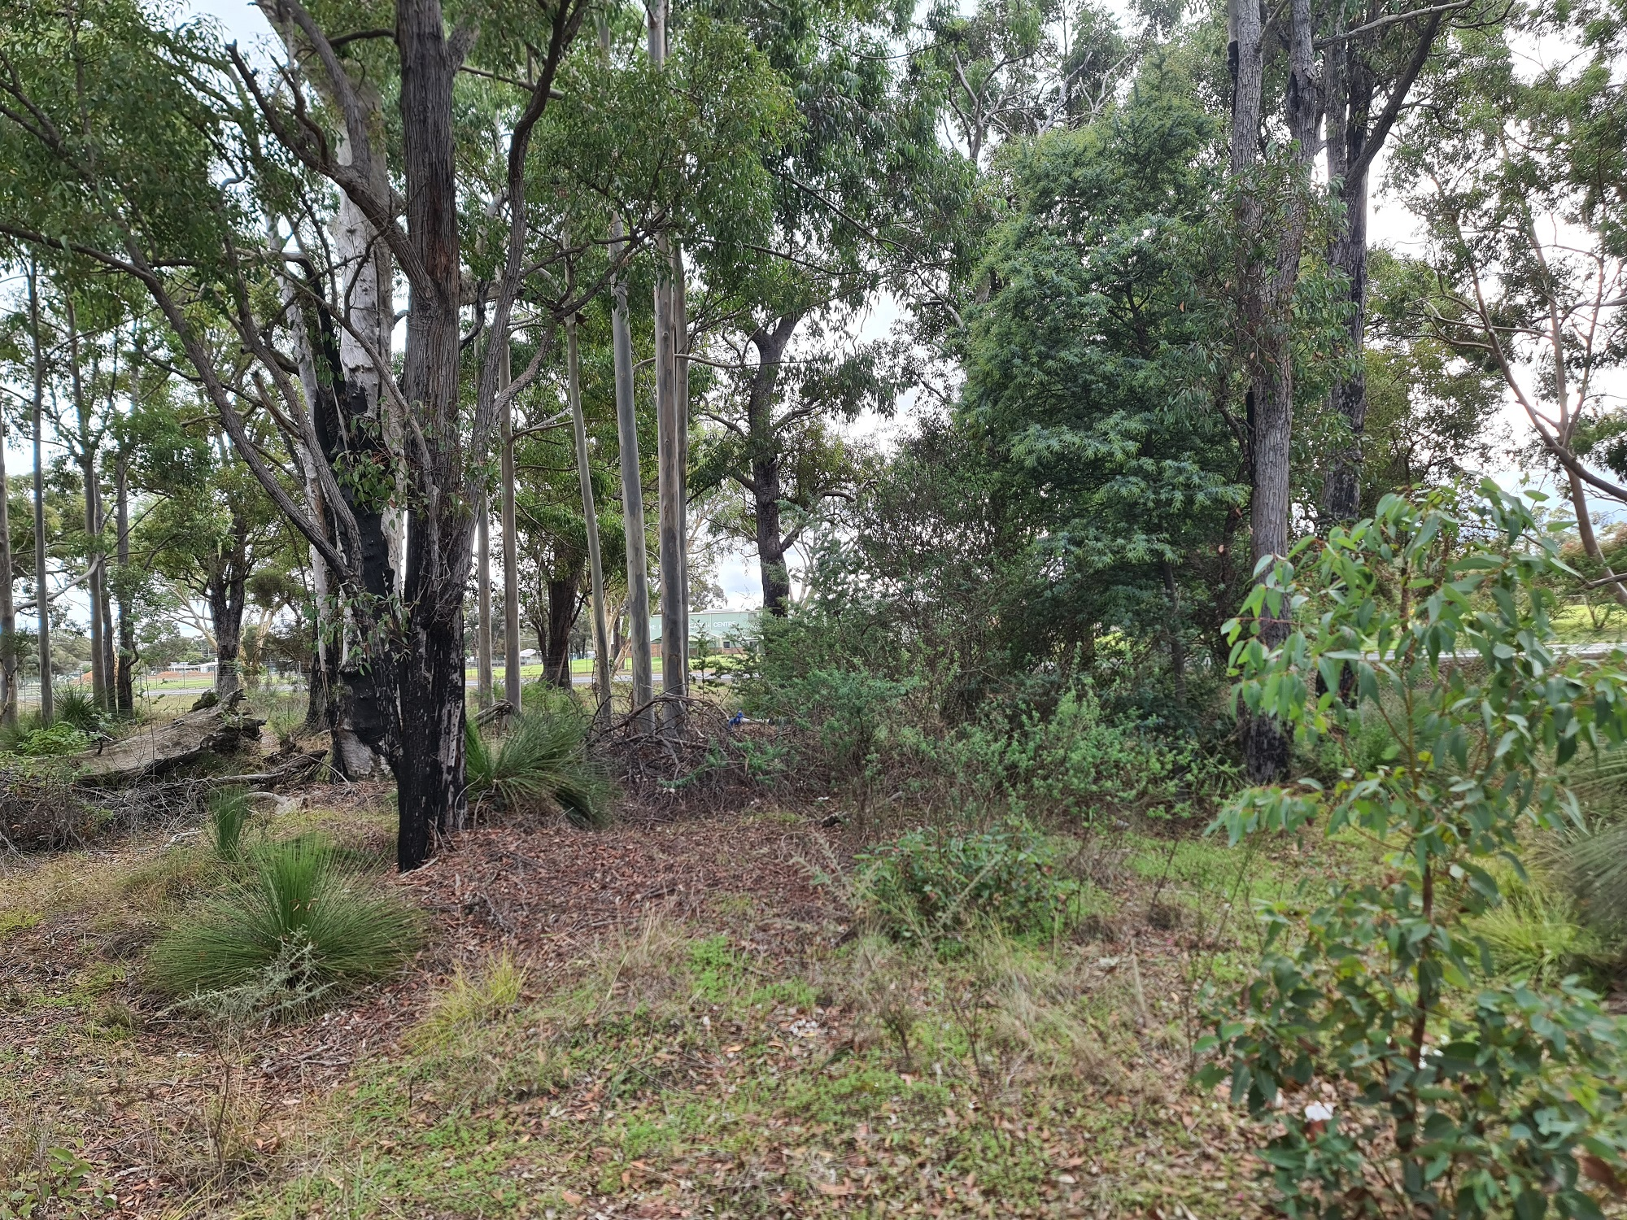
Route for water supply trench.
Small section of clearing circled in yellow. No trees to be removed.
Blue circle shows the location of the water meters.

Slide 8
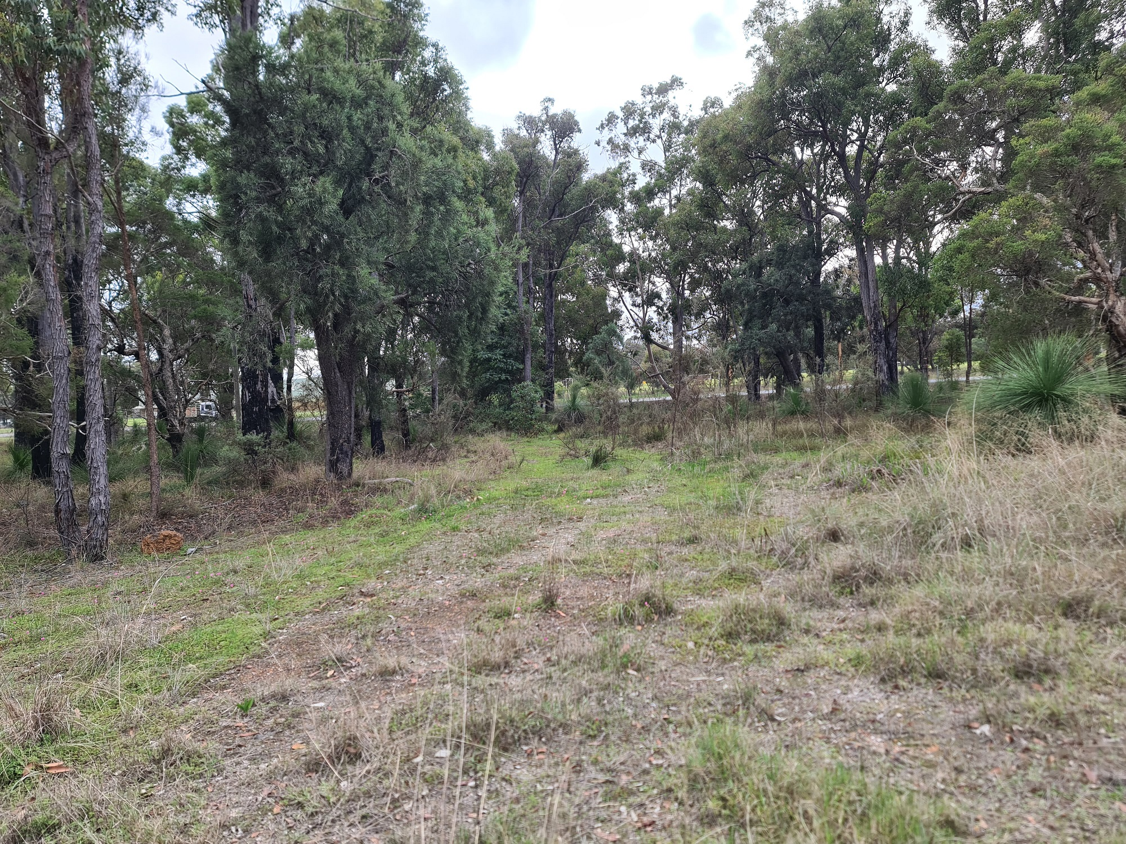
Route for water supply trench.

Slide 9
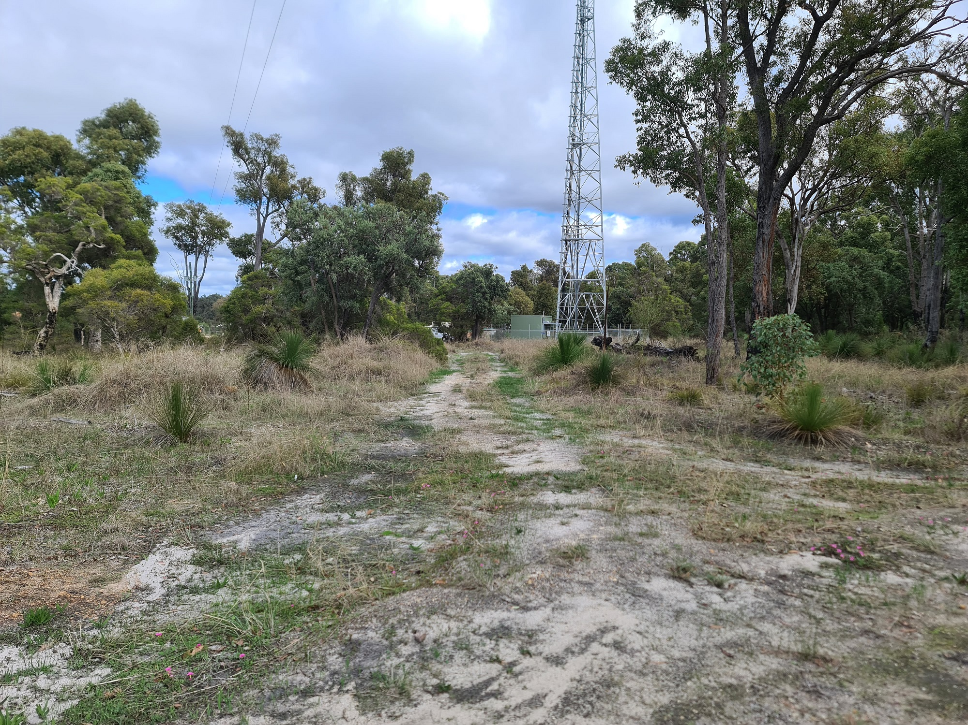
Route for water supply trench.

Slide 10
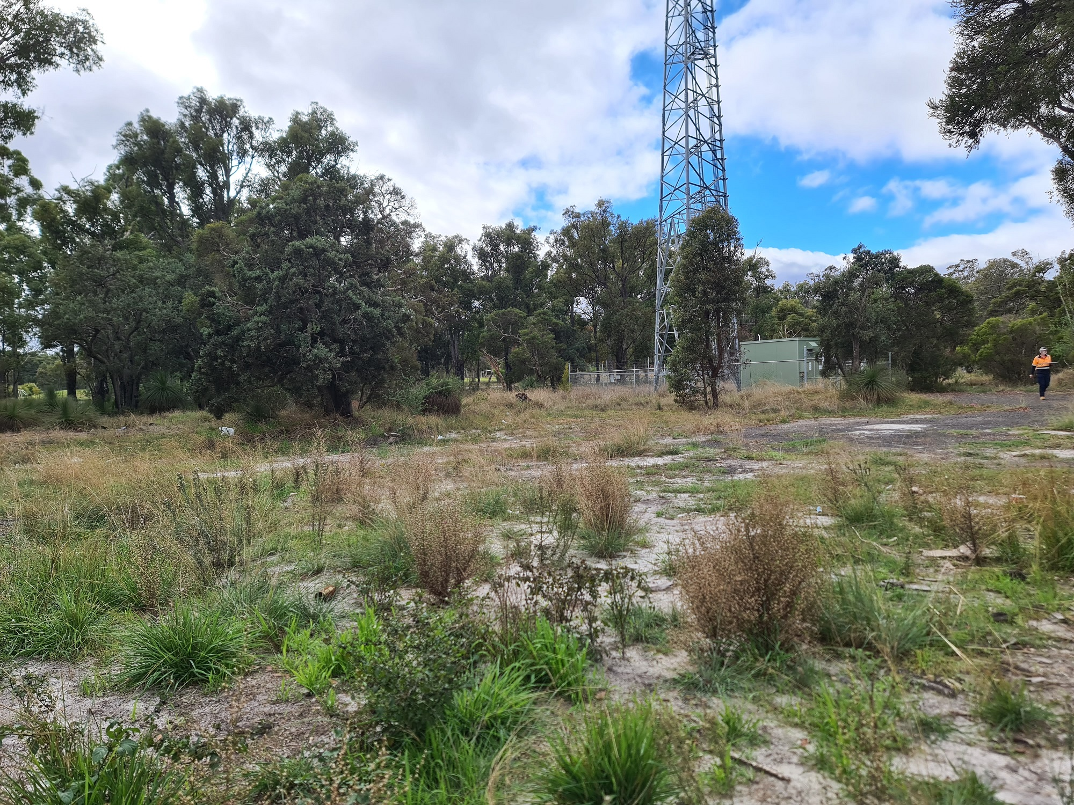
Start of shared trench.

Slide 11
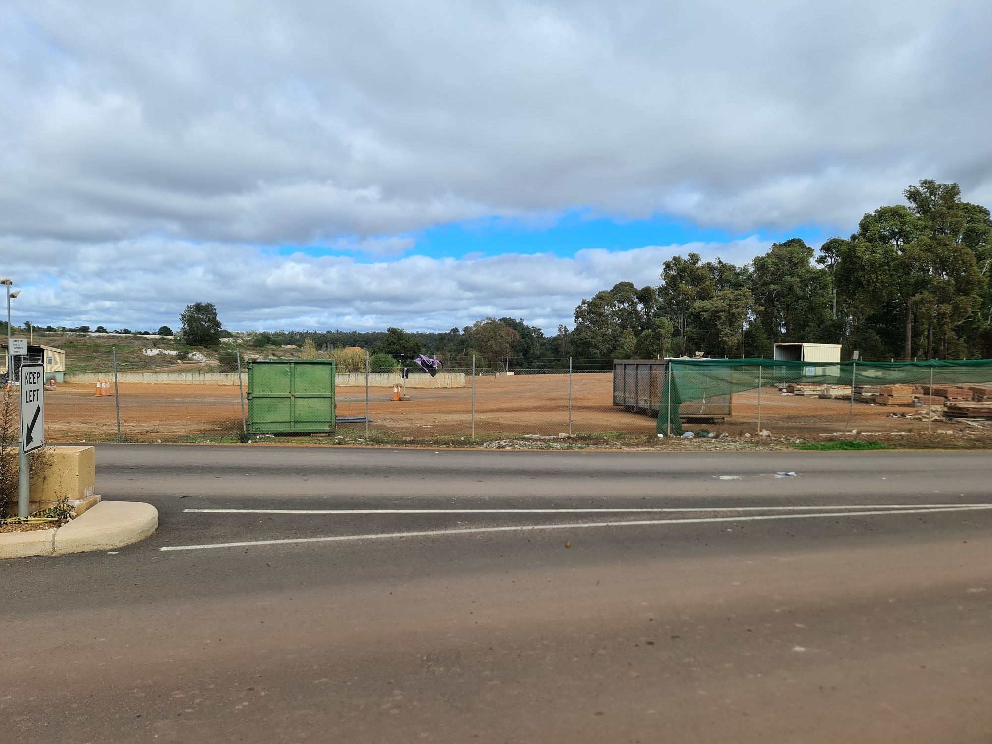
Route of directional drilling under road.

